Slide 1


Sustainability in Capital Markets
Evolution from Corporate Social Responsibility (CSR)
Abdulrahman Alfailakawi
Director of Markets Regulation

Slide 2





Capital Markets Authority
Regulate Market Entities
Regulate
Securities
Activities
Monitor Market Conduct
Supervise Financial Intermediaries
Raise Awareness
Approve Listed Companies
Develop the Market

Slide 3

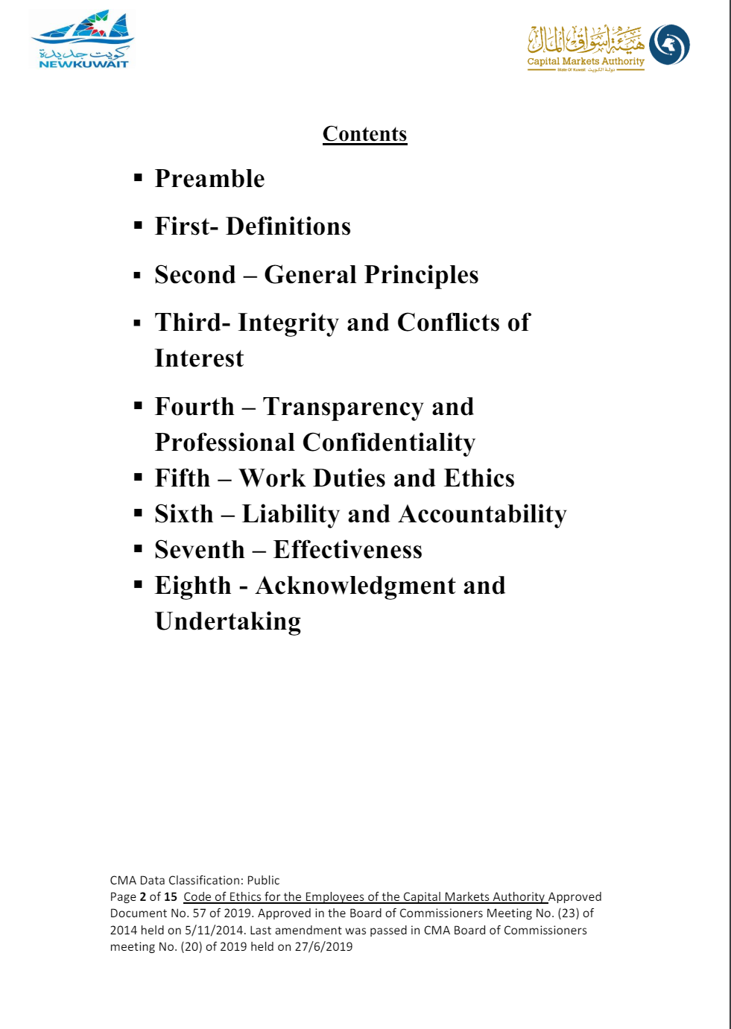
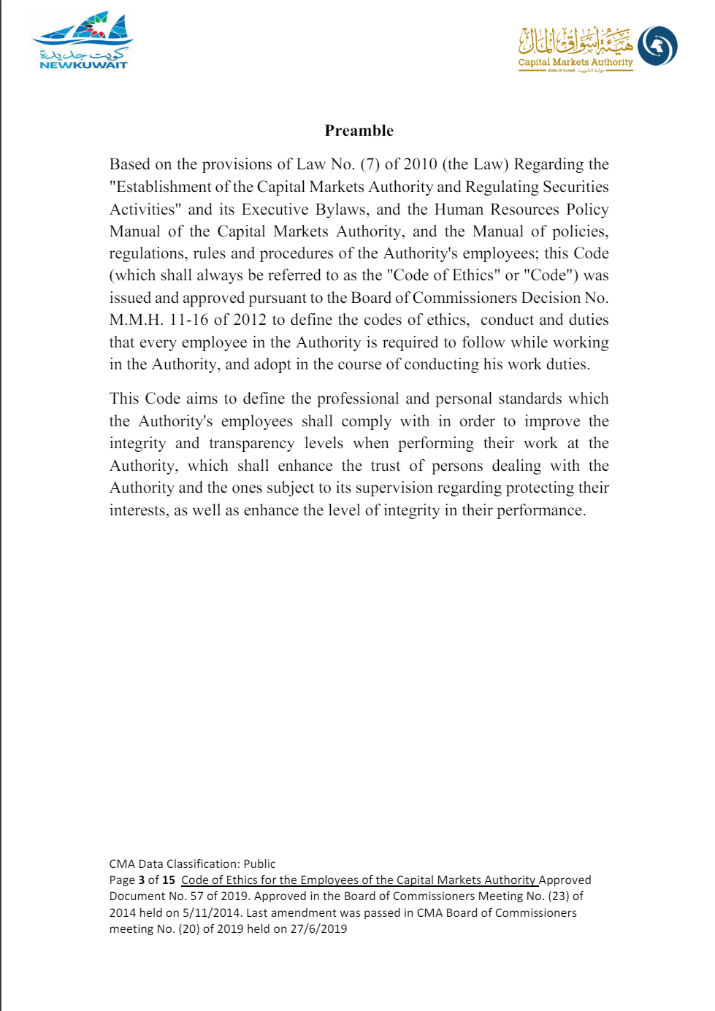
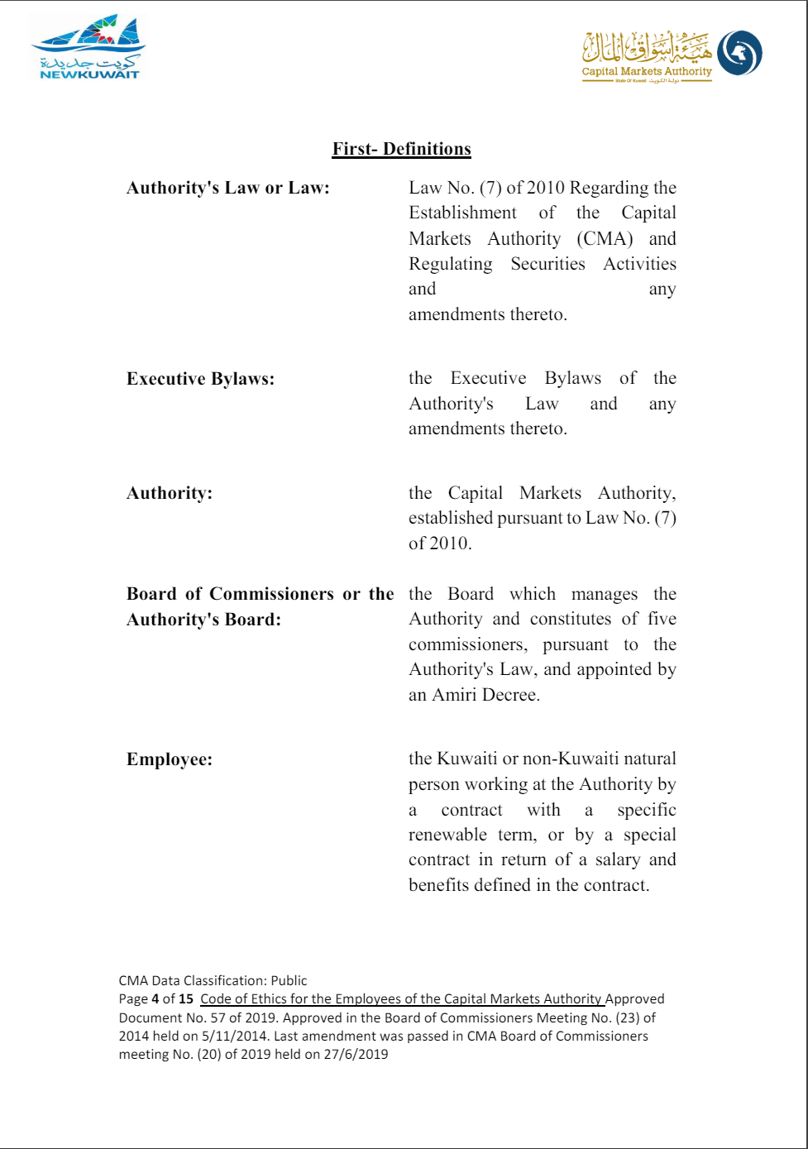
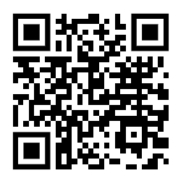
But First: Ethics
Integrity and Conflicts of Interest
Transparency and Professional Confidentiality
Work Duties and Ethics
Liability and Accountability
Effectiveness
Acknowledgment and Undertaking
Scan this!
Code of Ethics for CMA Commissioners.
Charter of Code of Ethics for CMA Employees.

Slide 4






It all Starts with Investors
Corporations are disciplined by their investors
Financial goals (return)
Non-financial goals
SRI
Socially Responsible Investing
GOALS
Investors
Shares
Capital
Profits / Shareholders
Stakeholders
Be ethical
CSR
Corporate Social Responsibility
GOALS
Corporations

Slide 5
Unprecedented Evolution: CSR to Sustainability
New global challenges ➔ CSR no longer fully captures the interests of investors
Corporate
Social
Responsibility
Environmental issues
Governance
Issues
Corporate Sustainability
Integrated in core business
Terminologies
Sustainability?
ESG?

Slide 6

What is Sustainability?
“Meeting the needs of the present without compromising the ability of future generations to meet their own needs.”
United Nations World Commission on Environment and Development (WCED), 1987

Slide 7
What is ESG?
“Environmental, Social, and Governance metrics that are used to assess a company’s impact and exposure to a range of environmental, social and governance factors and is a term mainly adopted by investors and rating agencies.”

Slide 8



Deep Dive: ESG Issues
Non-exhaustive! These are the major issues considered by investors and companies (but not all)
Environmental | Social | Governance
Climate change | Working Conditions | Board Structure
Stress on Natural Resources | Labor Rights | Business Ethics
Pollution | Human Rights | Executive Pay
Waste | Human Capital | Reporting & Transparency
 | Stakeholder Opposition
 | Product Liability

Slide 9




Deep Dive: Environmental Issues
Climate Change
Pressure on
Natural Resources
  Extreme weather events
  Global warming (main driver is gas emissions i.e CO2)
  Costly to mitigate or adapt with (Paris Agreement)
  Plants and animals (biodiversity)
  Fresh water
  Metals and minerals
Pollution
Waste
  Harms the environment and living species.
  10% of all deaths!
  Harms the environment and living species.
  Solutions could save costs (recycling)

Slide 10




Deep Dive: Social Issues
Working Conditions
Labor Rights
  Health & safety.
  Rana Plaza incident
  Minimum wage, child labor, equal pay.
  Right to organize (unions)
Stakeholder Opposition
Product Liability
  Companies know their products more than customers
  Legal repercussions
  Engage with the community
  Communicate with transparency

Slide 11




Deep Dive: Governance Issues
Board Structure
Business Ethics
  Skills
  Diversity
  Independence
  Culture that supports governance.
Executive Pay
Reporting
  Must be disclosed to shareholders
  Fixed pay / bonus /
  stock-based
  Integrity of financial statements
  Audit committee

Slide 12


Importance of Incorporating Sustainability
Risk Perspective
Return Perspective
Enhanced risk management by companies, better risk analysis by investors.
More efficiency and productivity, reduced costs and better demand.

Slide 13
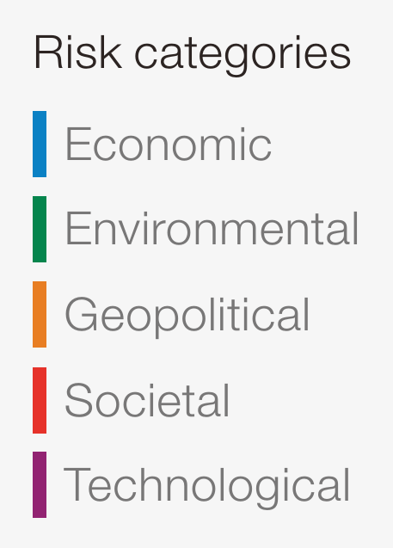
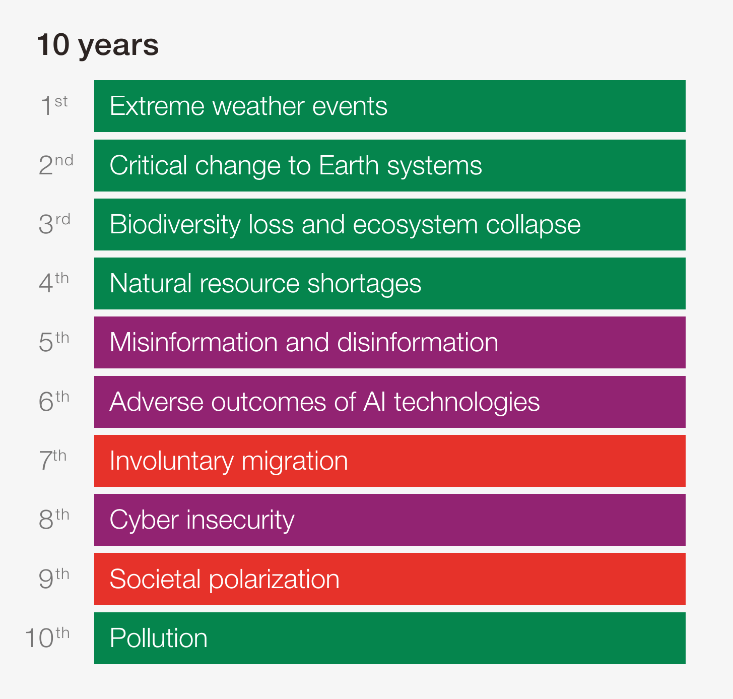
Risk Perspective: Top Global Risks (10 Years)
Source: The Global Risks Report 2024, World Economic Forum

Slide 14
Return Perspective: Documented Impact on Performance
The University of Oxford and asset manager Arabesque in 2014 reviewed the academic literature on sustainability and corporate performance, and found that out of the 200 studies analysed:
90% conclude that good ESG standards lower the cost of capital;
88% show that good ESG practices result in better operational performance; and
80% show that stock price performance is positively correlated with good sustainability practices.

Slide 15
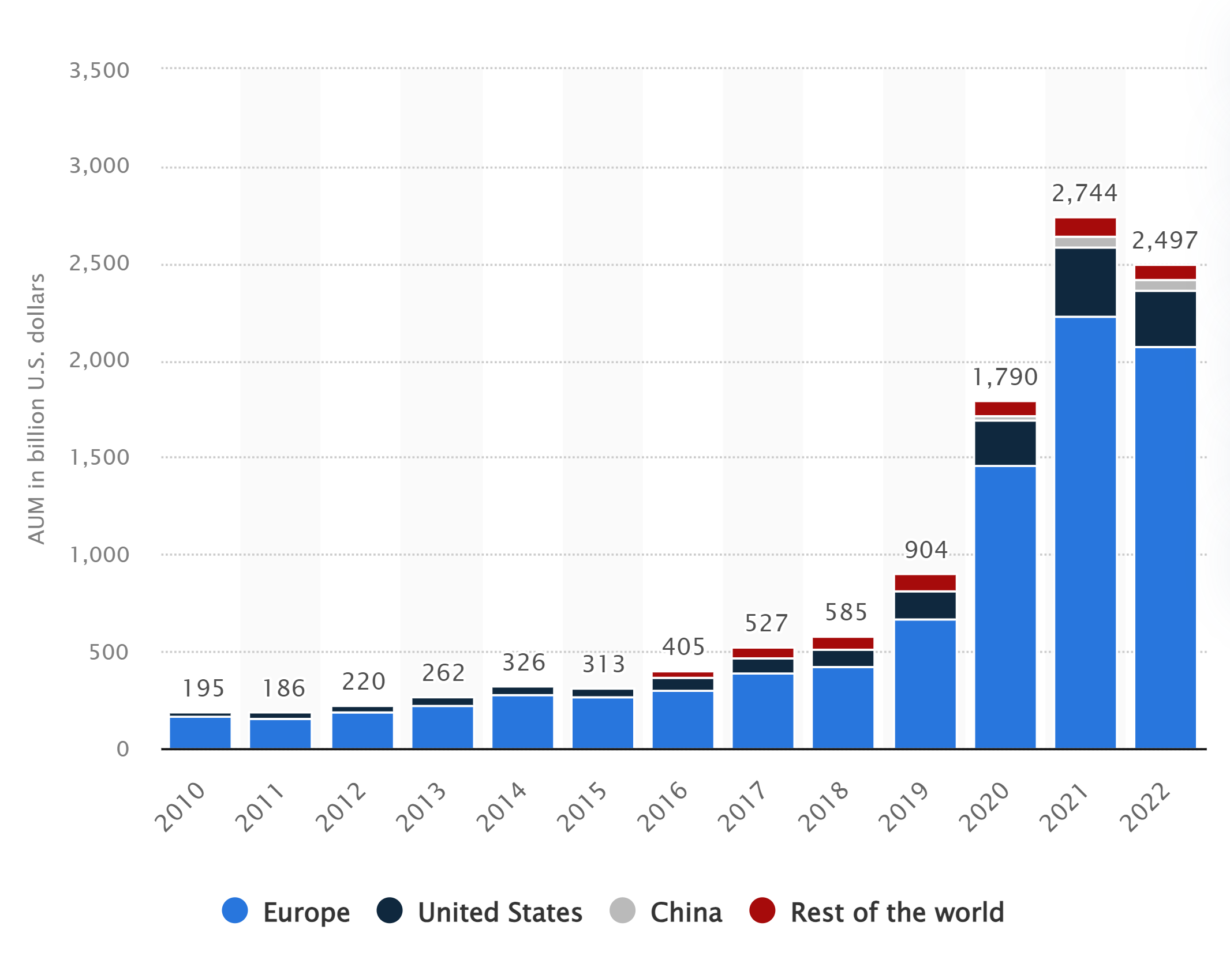
A View Validated by the Market
Assets under Management (AUM) in Sustainable Assets
Source: Statista
1,181%
growth in AUM

Slide 16
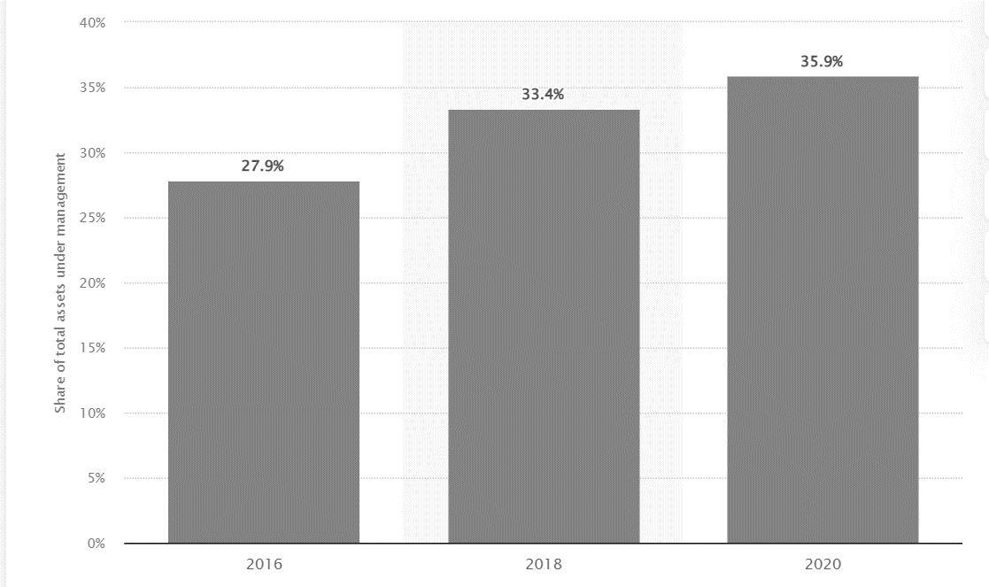
A View Validated by the Market
Sustainable Investments Proportion of Total AUM
Source: Statista

Slide 17


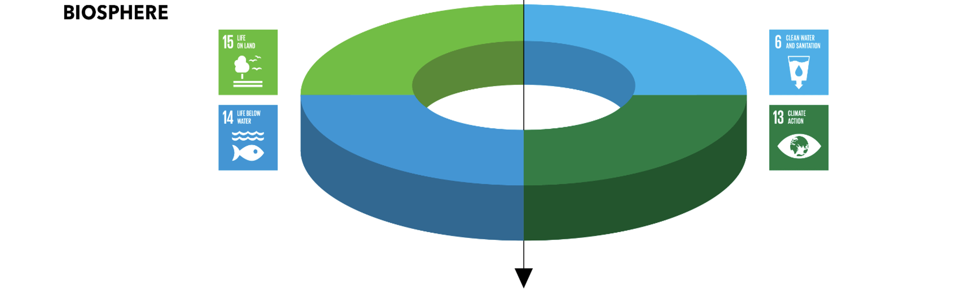
Investing for Tomorrow: Capital Markets' Contribution to Sustainability
Achieving the SDGs could create 380 million jobs and help unlock at least $12 trillion in opportunities for business by 2030!
Source: The Business & Sustainable Development Commission report: http://report.businesscommission.org/report
The SDGs are ambitious and estimates of the cost of achieving them range from $5-7 trillion per year
Source: Aberdeen Standard Investments: Embracing the UN’s Sustainable Development Goals in institutional investment, 2018

Slide 18
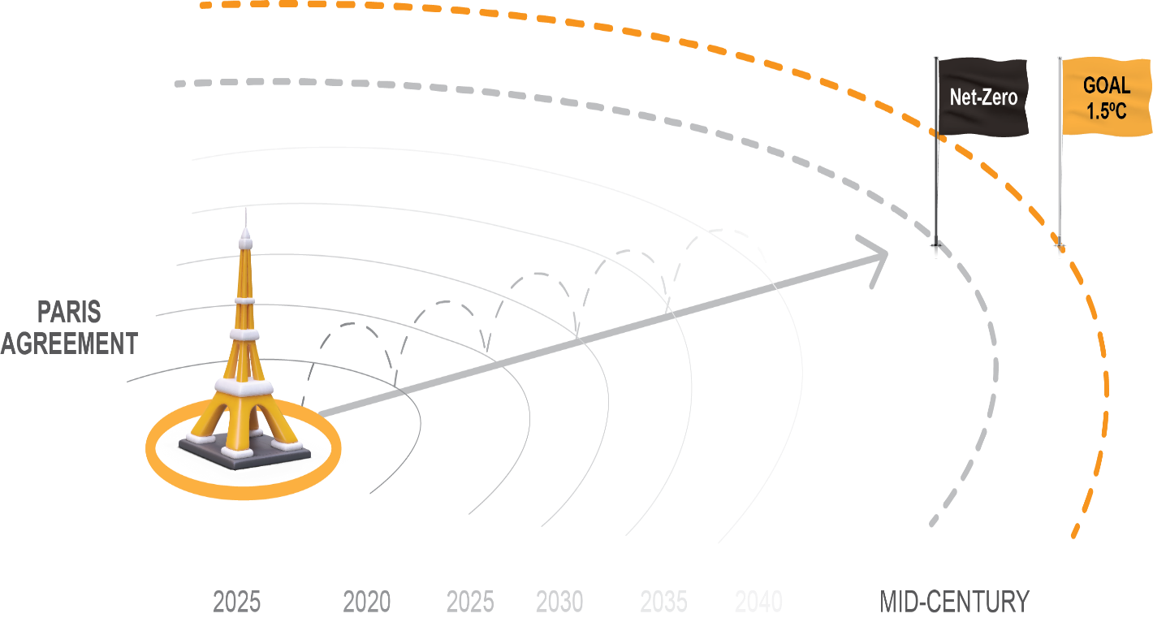
Investing for Tomorrow: Capital Markets' Contribution to Sustainability
  $4T annually to reach net zero emissions (2030-2050) –
  Source: International Energy Agency (IEA)

Slide 19
Sustainability Disclosures
According to PwC Global Investor Survey in 2023
75%
of investors, incorporate sustainability into their investment decision making.
95%
of investors believe corporate reporting on sustainability performance contains unsupported claims

Slide 20






Capital Markets Authority's (CMA) Role
CMA goals include:
Protecting Investors
Ensuring markets are fair, efficient and transparent; and
Avoiding systemic risks.
Monitor disclosures
Prevent
“Greenwashing”

Slide 21
Capital Markets Authority's (CMA) Role
Requirements
Impacted Parties
Requirements on Sustainability Reporting (voluntary)
Listed Companies
Governance Requirements
Listed companies + Licensed Companies
Mutual Funds Requirements
Products
Green Bonds Requirements
Products

Slide 22
Recent Observations: Kuwaiti Market

Slide 23
Thank You!
Q&A (10 minutes)

